Slide 1
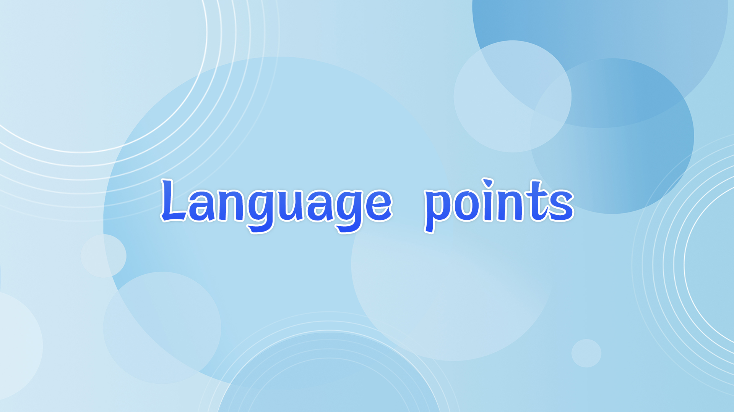

Slide 2
that引导的同位语从句
1. There is evidence that acupuncture dates back to the Stone
Age, when stone tools called bian were used to press areas of
the body.
有证据显示，针灸始于石器时代，当时一种名为“砭”的石器被用来按压身体部位。
when引导的非限制性定语句，用来解释说明the Stone Age
主从复合句，主句是there is evidence…, 主句里包含了一个that引导的同位语从句。

Slide 3
evidence U.
1) 证据；证明
We found further scientific evidence of/for this theory. ...的证据
有明确的证据表明暴露在阳光下与皮肤癌之间存在联系。
There is clear evidence of a link between exposure to sun and skin cancer.
= There is clear evidence that there is a link between ...
2) 物证；人证；证词
He refused to give evidence at the trial. 作证
be in evidence 显而易见 be clearly seen
Nowadays, Asia’s strength as an exporter is growing in evidence.

Slide 4
evident adj. 清楚的；显而易见的；显然的 obvious, apparent
The orchestra played with evident enjoyment.
管弦乐队演奏得兴致勃勃。
1. It is evident (to sb) that (某人)显然……
我们现已清楚知道出了差错。
It is now evident to us that a mistake has been made.
2. evident in... 在某方面显而易见
The growing interest in history is clearly evident in the number of people visiting museums and country houses.
Notes:
从参观博物馆和乡村住宅的人数明显看出人们对历史越来越感兴趣。

Slide 5
【语境应用】语法填空。
1) ____ _____ ______ ____ (有迹象表明) Beijing Man used fire to cook food.
2) It was evident ________ me that he was not telling the truth.
3) It sounds resonable, but the text __________ (evidence) ignored the fact that humans, particularly teenagers, rarely seem reasonable.
4) Evidence has been found through years of study ________
children’s early sleeping problems are likely to continue
when they grow up.
There is evidence that
to
evidently
that

Slide 6
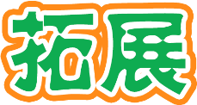
date back to = date from 追溯至
date from和date back to 一般不用于进行时态。作后置定语时, 常用动词-ing形式。
This temple dates back to the 5th century.
The building dates from the 13th century.
We need to set/fix a date for the next meeting. 定日期
The exhibition contains some of his best work to date. 迄今为止 until now

Slide 7
【语境应用】语法填空。
1) “Niren Zhang”, or Clay Figurine Zhang, ________(date) back to 180 years ago and is a traditional Chinese folk art originating in Tianjin.
2) All these trees are over 800 years old, with some ________
(date) back to 1,000 years ago.
3) All the photographs in this book, unless stated otherwise,
date ________ the 1950s.
4) To date it ________ (sell) more than 20 million copies globally through game distribution platform Steam, bringing in gross revenue of over US$961 million.
dates
dating
from
has sold

Slide 8

2. ... the majority have now switched to stainless steel
ones. 多数医师已经改为……
switch vi.&vt.:
1) 开/关电器、灯 Please switch the lights off as you leave.
2) 转变
Press these two keys to switch between documents on screen.
When did you switch jobs?
3) 交换，调换，调班
Do you think she'll notice if I switch my glass with hers?
I can't work next weekend— will you switch with me?

Slide 9
switch n. 开关；转变，改变
turn on/off the light switch 电灯开关
She made the switch from full-time to part-time work when her first child was born.
【语境运用】
1. For some reason, when certain shows ______ _____ (切换到) a commercial, a loud noise would sound for a few seconds.
switched to

Slide 10
2) Do you think she’ll notice if I ________ ________ ________ ________ ________ (把我的包与她的交换)?
3) They had to ________ ________ ________ (作改变) in their plan because of the bad weather.
4) ________ ________ ________ ________ (打开灯) and you can do your homework. But don’t forget to _________ _________ the light after finishing your homework.
switch my bag
with hers
make a switch
Switch on the light
switch off

Slide 11
3. examine the patient 检查病人 look at sb/sth closely
The goods were examined for damage on arrival.
examine v. consider or study sth very carefully 审查；调查；考查；考察
It is necessary to examine how the proposals can be carried out.
The students will be examined in all subjects at the end of term.
examination n.
1. a medical examination report
2. Your proposals are still under examination.
健康检查报告
在审查中
Notes:
有必要调查一下怎样才能实施这些方案。
你的提议仍在审查之中。

Slide 12
4. Up to now, more than 360 acupuncture points have been identified, each linked to a different part of the body.
句中each linked to…是独立主格结构，linked to…是
过去分词短语，其逻辑主语each指代each acupuncture point。
西蒙坐在沙发上，双臂交叉在胸前。
Simon was sitting on the sofa, his arms crossed in front of his chest.

Slide 13
【语境应用】完成句子。
1) 有那个男孩带路, 我们没费什么力气就找到了村子里的学校。
A boy _______________, we had no trouble finding the school in the village. (lead)
2) 随着问题的解决, 质量已经提高了。
__________________, the quality has been improved. (solve)
3) 他走进屋来, 脸色苍白。
He entered the room, ____________.
leading the way
The problems solved
his face pale

Slide 14
5. ... including severe pains, blood pressure issues, stomach discomfort, sports injuries and weight problems.
包括剧烈疼痛、血压问题、肠胃不适、运动损伤和体重问题等。
severe adj. 1) serious, grave 十分严重的，极为恶劣的
恶劣的天气情况
遭到惨败
2) harsh (punishment) 严厉的
a severe punishment 严厉的，重的惩罚
be severe with oneself 严于律己 be strict with
3) very difficult and needing a lot of effort and skill 艰难的
The marathon is a severe test of stamina. 对……的严峻考验
severe weather conditions
suffer severe losses
Notes:
The head teacher spoke in a severe voice.

Slide 15
【语境应用】翻译下面句子。
1) The head teacher spoke in a severe voice.
班主任老师用严厉的声音说道。
2) This is a school for children with severe learning difficulties.
这是一所专门为学习上有严重困难的孩子们开设的学校。
severely adv.
深受失业影响的地区
severity n.
问题的严重性
areas severely affected by unemployment
the severity of the problem

Slide 16
anxiety n.
be anxious for/about
be anxious + 从句
be anxious for sth.
be anxious to do sth.
be anxious for sb. to do sth.
be anxious + 从句(从句谓语常用“should+动词原形”)
为……担心/担忧
渴望……

Slide 17
【语境应用】完成句子。
1) Why was she so _____________________ (渴望我留下)?
2) Parents are naturally ____________________________ (为他们的孩子担心).
3) I'm anxious that ________________________ (我们应该准时到达那里) because I don't think there'll be many seats left.
4) Children normally feel al lot of ______________ their first day at school. (对……焦虑)
5) He has _____________________ (强烈渴望获胜) in the race.
anxious for me to stay
anxious for/about their children
we should get there on time
anxietry about
a strong anxiety to win

Slide 18
6. Acupuncture has also been applied to treat people who abuse alcohol, tobacco or drugs.
针灸也用来治疗嗜酒、嗜烟、嗜毒人群。
abuse vt. 1) 滥用 abuse one’s power 滥用权力
辜负信任
2) 虐待
All the children had been physically and emotionally abused.
3) 辱骂
The referee had been threatened and abused.
abuse trust

Slide 19
abuse n.
drug abuse 嗜毒
abuse of power 滥用权力
他遭受了多年的心理摧残。
He suffered years of mental abuse.

Slide 20
【语境应用】写出下面句子中画线单词的词性和中文释义。
1) Rose said she had been a victim of child abuse.
________ ________
2) He showed how the rich and powerful can abuse their position. ________ ________
3) What she did was an abuse of her position as manager.
________ ________
4) Unfortunately, when the police found the children, they had been abused physically and emotionally.
________ ________
n. 虐待
v. 滥用
n. 滥用
v. 虐待

Slide 21
7. substance
1) 物质 C 一种化学物质 a chemical substance
2) 事实依据 U
It was rumor, completely without substance. 没有事实根据
缺乏事实根据
There is no substance in any of these accusations.
这些指控都毫无根据。
3) 要点，实质
The substance of his discussions doesn't really matter.
I agreed with what she said in substance, though not with every detail. 本质上
lack substance
Notes:
他讨论的要点实际上根本不重要。

Slide 22
substantial adj. 重大的，价值巨大的 considerable
substantial sums of money
a substantial change
The costs have increased substantially.
成本大大提高了。
大笔的钱
重大变化
Notes:
他讨论的要点实际上根本不重要。

Slide 23
8. ...is recognized as a symbol of traditional Chinese culture and has come into widespread use around the world.
symbol n. 1) 象征
The dove is a symbol of peace
2) 符号，代号
What’s the chemical symbol for iron?
symbolize vt. symbolic adj. 象征性的
Red ____________ good luck in many cultures. (是……的象征)
Red ____________ good luck in many cultures.
Red is symbolic of good luck in many cultures.
Its name sounds like “higher year”, carring the _______ (symbol) meaning of progress in both career and life.
is a symbol of
symbolized
symbolic
Notes:
The Channel Tunnel has enormous symbolic significance for a united Europe.
英吉利海峡隧道对于建立一个统一的欧洲具有重大的象征意义。

Slide 24
【语境应用】用symbol, sign, signal或mark填空。
1) Scientists have found no ________ of life on Mars so far.
2) All I get is a busy ________ when I dial George’s cell
phone number.
3) All the students, please put a ________ by the subjects
you are interested in.
4) I frequently use sunflowers as a ________ of strength.
sign
signal
mark
symbol

